Slide 1
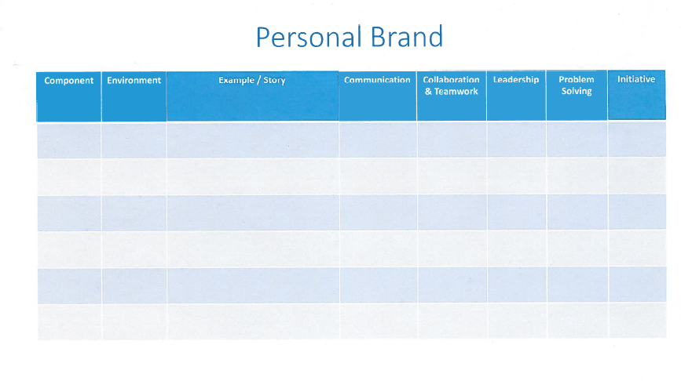
Bypassing the
anti-spider
design
A depression test based on
social media by using spider
Interfacing with
software designers
Design interface
for data analyst
of the program
Spider
Python
Server storage
monitor
A SMS auto alarm system about
the server capacity based on python
Checking the demand
of the server maintenance
stuff
Be sure the app is meet the demand a user friendly
From mail iteration
to short-term.
And the usage of SMS API
Python
Using SMS
QA machine manage system
A manage system in order to standardize the using of testing machine.
Checking the business rules
of machines management
Continue to communicate with the administrator to make sure it meet the design of software model
The usage of rich text edditor.
Java

